Slide 1
Lending Loan Club Analysis (Good vs Bad Loans)
File created on: 11/24/2020 4:55:08 AM

Slide 2
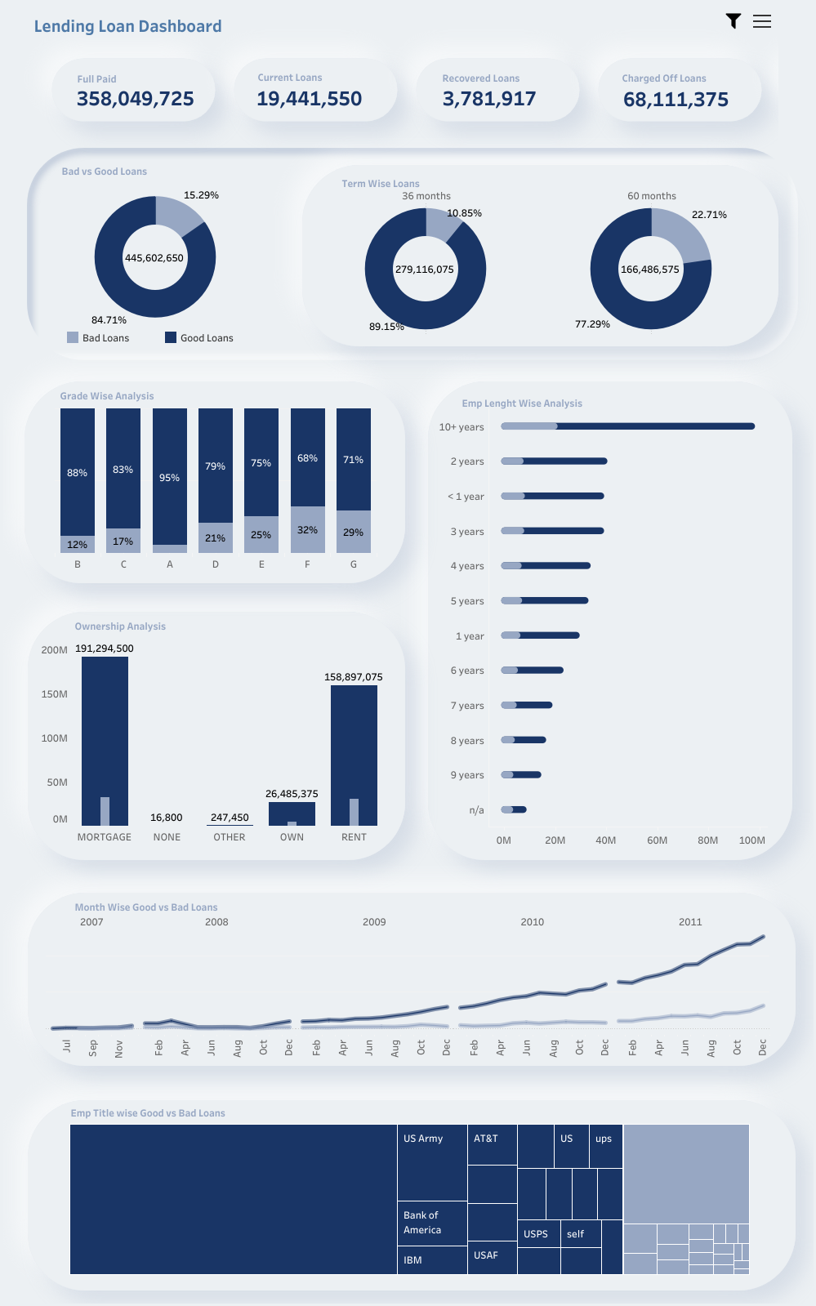

Slide 4
